Slide 1
Key Concept 5.3
Rebellion and Reforms

Slide 2
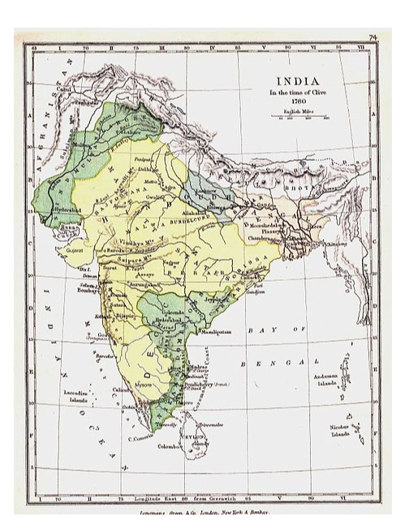
A. Subjects challenged centralized imperial governments.
Example: Challenge of the Marathas to the Mughal Sultans
Fought a 27 year war with the Mughals
Re-established Hindu rule in India
Able to keep British at bay for awhile

Slide 3
A. Subjects challenged centralized imperial governments.
Ex: The Taiping Rebellion
Civil War-ish
Taiping Heavenly Kingdom vs. Qing (France/UK)
Hong Xiuquan thinks he's Jesus' Little Bro

Slide 4
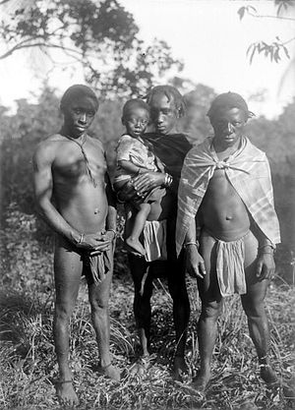
C. Slave resistance challenged existing authorities in the Americas
Individual Acts of Rebellion
pretend to be ill
refuse to work
do their jobs poorly
destroy farm equipment
set fire to buildings
steal food
Nat Turner
Organized Efforts
Underground Railroad
Maroon Societies - Run away slaves
Some blended in in the cities
Others lived in mountains or forests

Slide 5
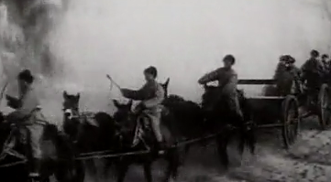
D. Increasing questions about political authority and growing nationalism contributed to anti-colonial movements.
Examples:
The Indian Revolt of 1857
The Boxer Rebellion
Against Foreign Influence
Especially Missionaries

Slide 6
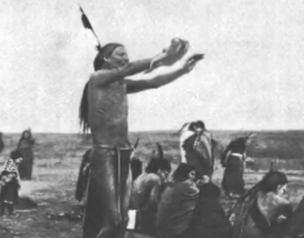
Some of the rebellions were influenced by diverse religious ideas.
Examples:
The Xhosa Cattle-Killing Movement
African & British Imperial Powers
The Ghost Dance
Native American religious movement

Slide 7
Responses to increasingly frequent rebellions led to reforms to imperial policies.
Examples:
The Self-Strengthening Movement -1861
Which Country?
Why?
The Tanzimat Movement - 1839-70s
Response to?
Reforms in the Ottoman Empire
Change from Theocracy to Modern State
Islamic Law to Secular Law
Uniting all Ottomans

