Slide 1
Imperialism

Slide 2
Why?
Social Darwinism
the weak were diminished and their cultures delimited while the strong grew in power and in cultural influence over the weak
White Man’s Burden
It’s our “job” to civilize these people
Take up the White Man's burden —
Send forth the best ye breed —
Go bind your sons to exile
To serve your captives' need;
To wait in heavy harness,
On fluttered folk and wild —
Your new-caught, sullen peoples,
Half-devil and half-child.
Rudyard Kiplings’s 1899 Poem

Slide 3
Monroe Doctrine
1823
Short Version: This is our “Sphere”
Long Version: to free the newly independent colonies of Latin America from European intervention and avoid situations which could make the New World a battleground for the Old World powers, so the US can control the situation

Slide 4
Spanish-American War
USS Maine - Pulitzer and Hearst
Cuban War for Independence
Pacific Theatre v. Caribbean Theatre
America Gains
The Philippines
Cuba
Puerto Rico
Guam

Slide 5
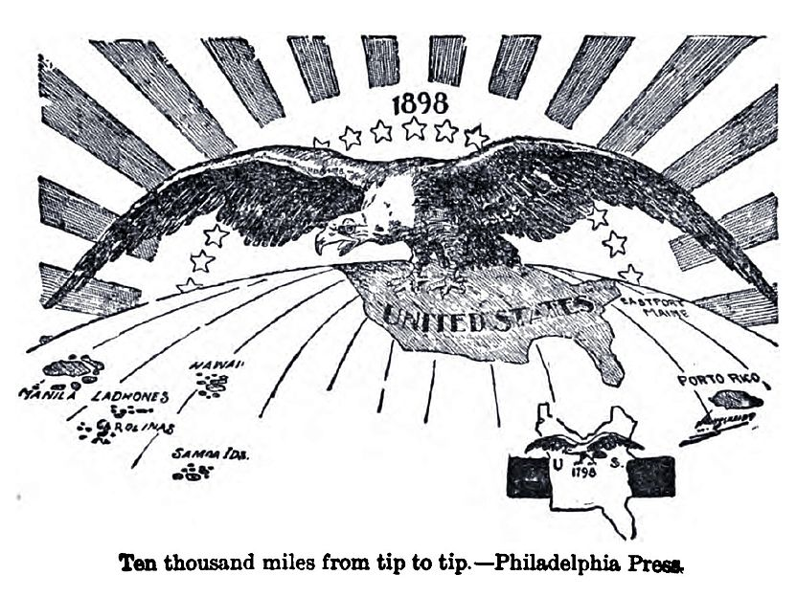

Slide 6
India

Slide 7
India
The British were perhaps the most successful pirates in history. They came to India pillaged the country in the name of trade and then enslaved it in the name of civilization.
Buckminster Fuller ~ Philosopher

Slide 8
BEIC
Cotton, silk, indigo dye, salt, tea and opium
Military Authority
Fought off the Dutch & French for control
In control until 1857

Slide 9
Sepoy Mutiny
1857
Sepoys: Indian soldiers who were recruited into the BEIC’s army
Series of injustices
Final Straw: Enfield P-53 rifle
Switch from Indirect Rule to Direct Rule

Slide 10
East Asia

Slide 11
Opening of Japan
1720 – Ban on western books ended (medicine)
1853 – Matthew Perry – “Look at my guns”
1854 – Perry wins right to station an American consul in Japan
1856 – 2 ports opened to commerce
1866 – American Civil War surplus weapons find their way to the samurai

Slide 12
Meiji Restoration
Coup d’etat by Samurai – No more Shogun
Brief Civil War
“Enrich the country, strengthen the army”
All feudal class privileges abolished
Universal conscription
Universal education – western learning

Slide 13
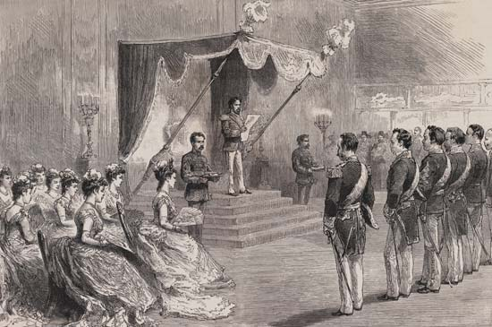
The Meiji emperor proclaiming the Meiji Constitution in 1889.

Slide 14
China

Slide 15
Barbarians at the Southern Gates
Chinese are real full of themselves
British needs something they can trade for Silk, porcelain, tea, etc.
Answer: Opium
India grew it
China accepted it, and eventually began exporting silver
Too many stoned people -China bans Opium in 1839
British "Free Trade"

Slide 16
The Opium Wars
By Sea: Junks are no match for British Gunboats
By Land: Soundly defeated by British Forces
Emperor has no choice but to sue for peace

Slide 17
After the Opium War
Britain gets Hong Kong as a colony
5 Treaty Ports -Foreigners live and work under own laws
Extraterritoriality - France & U.S. follow
And there’s still lots of opium flowing in

Slide 18
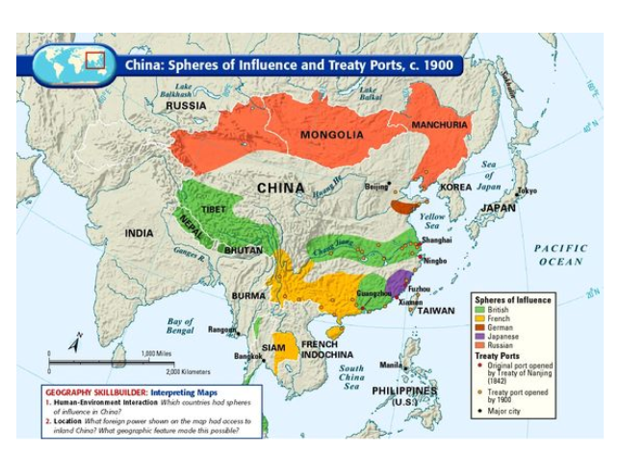
Spheres of Influence
a country or area in which another country has power to affect developments although it has no formal authority.

Slide 19
Self-Strengthening Movement
Response to rebellions/upheavel
Encouraged Western investment in railways and factories
Modernized army

Slide 20
Thailand (Siam)
King Mongkut and King Chulalongkorn
Negotiate with British and French to maintain independence
Bowring Treaty - abolition of trade barriers replaced Siamese commerce with free trade

Slide 21
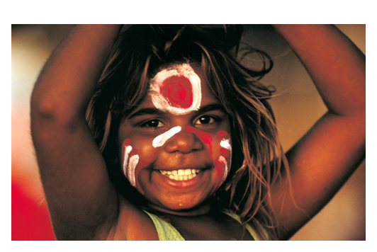
Australia
Natives are called Aboriginals
We give James Cook credit for settling Australia - 1770
Origins as a penal colony until 1848
Native Populations Decline
"Stolen Generations"
Settler Colony

Slide 22
Africa

Slide 23
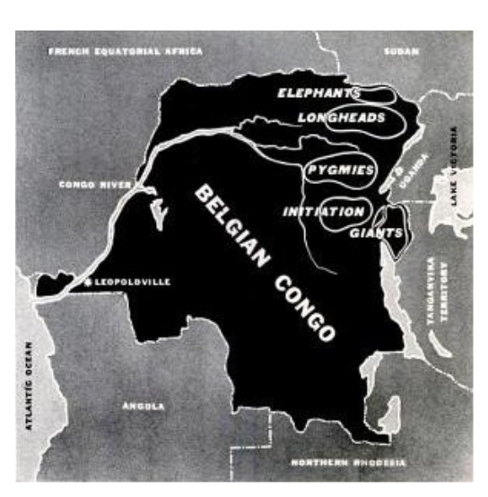
The Belgian Congo
Dr. Livingstone
Henry Stanley
King Leopold

Slide 24
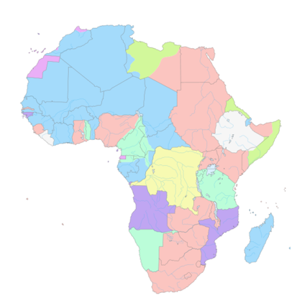
Berlin Conference (1884-1885)
-Formalized the "Scramble for Africa"
-coincided with the rise of Germany as an imperial power
-international prohibition of the slave trade was signed
-Only independent nations left: Ethiopia and Liberia
-Liberia: Home to returning freed slaves from U.S.

Slide 25
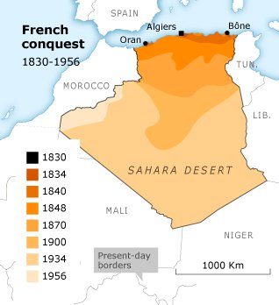
French Algeria (1830-1962)
Began: blockade of Algiers by the French navy
France doesn’t care about the interior
Settler Colony

Slide 26
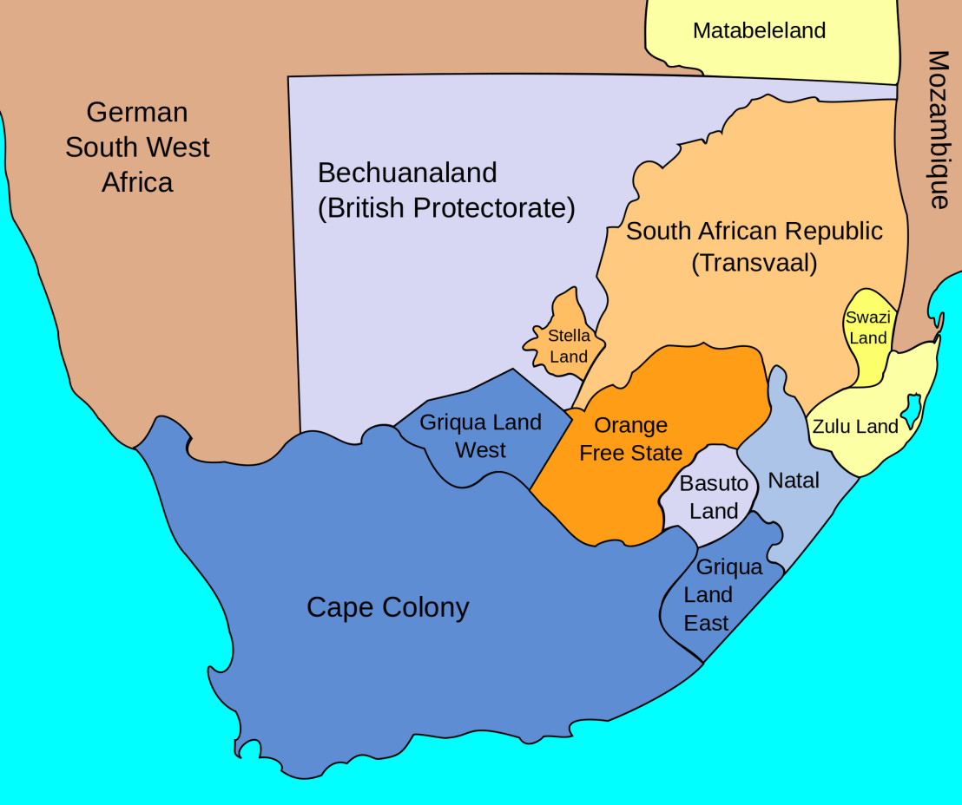
Boers
Dutch word for Farmer
Settler Colony
Afrikaans: West Germanic language (Creolized)
Originally overseen by the DEIC

Slide 27
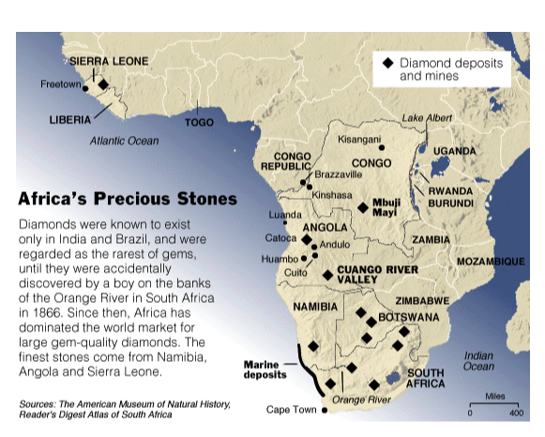
Gold and Diamond Mines in South Africa
1870-80s - first commercial mining of diamonds and gold
region became a magnet for European investment
Mining in the region predated European arrivals by several centuries
1886 Gold first mined by Europeans near Johannesburg
Most important sector in the mining industry
S. Africa has almost ½ of the world's known gold reserves

Slide 28
Boer Wars
1st War 1880-1881: Winner?
2nd War 1899-1902: Winner?
Effects:

