Slide 1
Africa in the Post-Classical Era
According the College Board

Slide 2
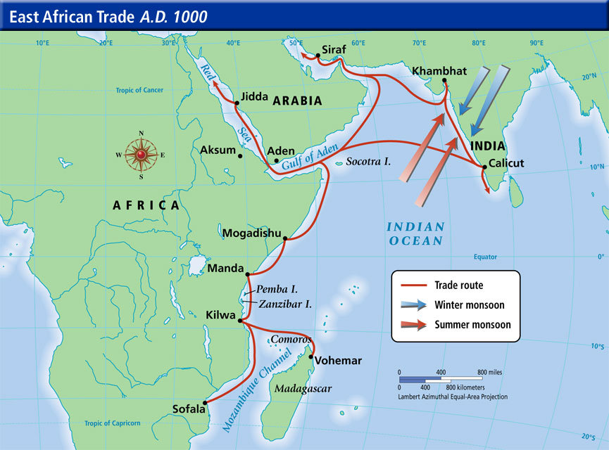
3.1 I. A. Existing trade routes flourished and promoted the growth of powerful new trade cites
Swahili City States
Merchants traded gold, slaves, and ivory for pottery glassware, and textiles from Persia, India, and China

Slide 3
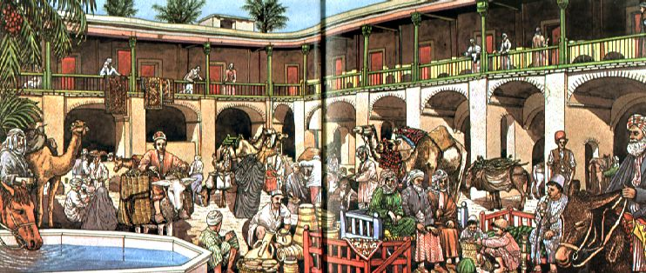
3.1. I. C. The growth of interregional trade in luxury goods was encouraged by significant innovations in previously existing transportation and commercial technologies.
Caravanserai - an inn with a central courtyard for travelers in the desert regions of Asia or North Africa.

Slide 4
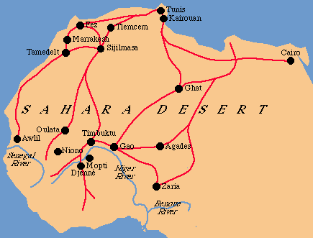
3.1 II. A. The expansion and intensification of long-distance trade routes often depended on environmental knowledge and technological adaptations to it.
The way the Berbers adapted camels to travel across and around the Sahara.

Slide 5
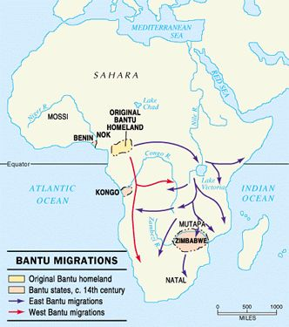
3.1 II. B. Some migrations had a significant environmental impact
The migration of Bantu-speaking peoples who facilitated transmission of iron technologies and agricultural techniques in Sub-Saharan Africa.

Slide 6
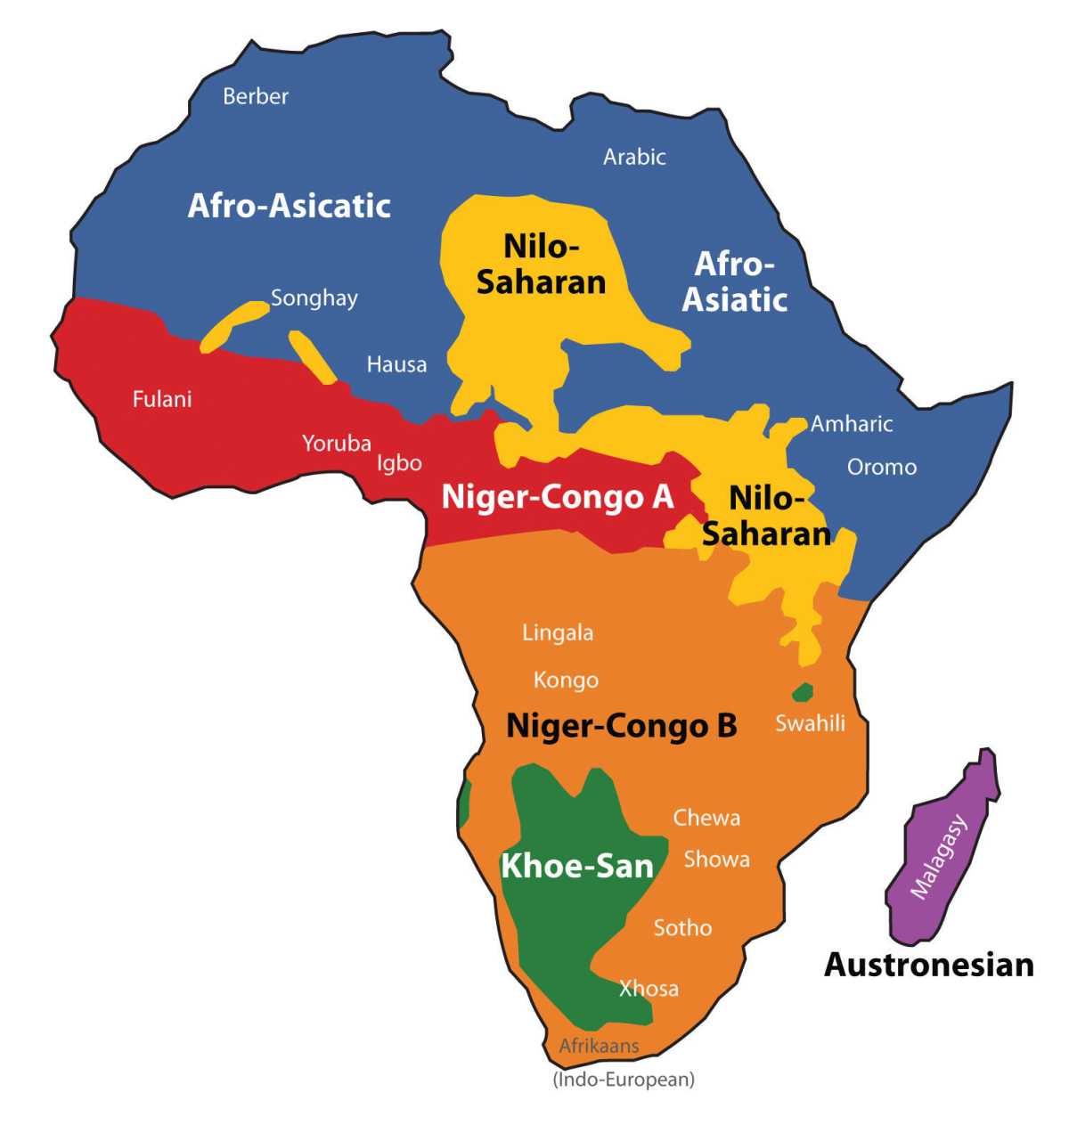
3.1 II. C. Some migrations and commercial contacts led to the diffusion of languages throughout a new region of the mergence of new languages.
The spread of Bantu languages
The spread of Turkic and Arabic languages

Slide 7
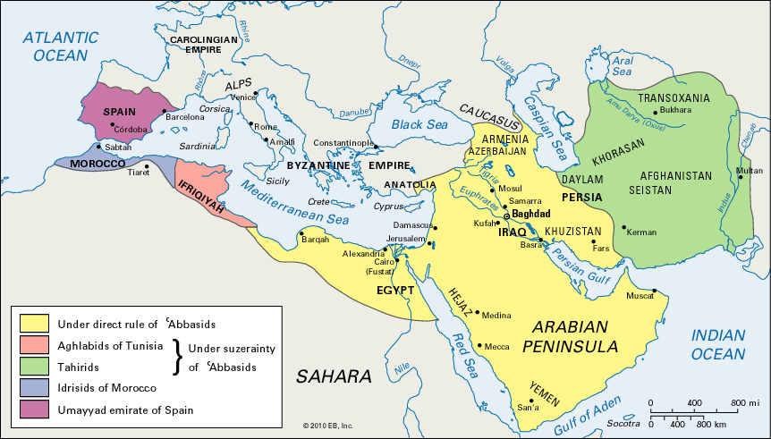
3.1 III. A. Muslim rule expanded to many parts of Afro-Eurasia due to military expansion.

Slide 8
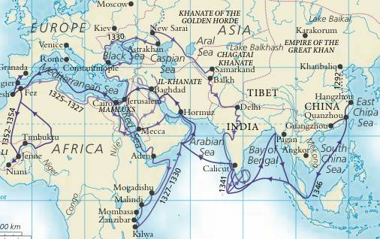
3.1 III. C. As exchange networks intensified, an increased number of travelers within Afro-Eurasia wrote about their travels.
The travels of Ibn Battuta

Slide 9
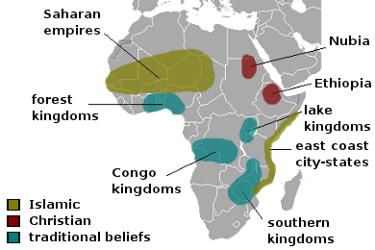
3.1 III. D. Increased cross-cultural interactions resulted in the diffusion of literary, artistic, and cultural traditions.
The spread of Islam in Sub-Saharan Africa

Slide 10
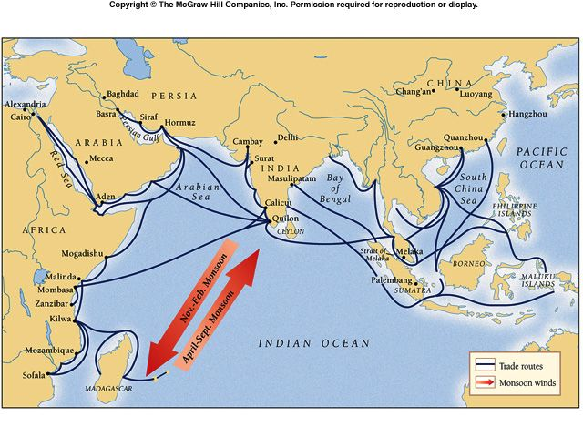
3.1 IV There was continued diffusion of crops and pathogens, including epidemic diseases like the bubonic plague, through the Eastern Hemisphere along the trade routes.
Seaborne immigrants from Indonesia or Malaya bring bananas and coconuts

Slide 11
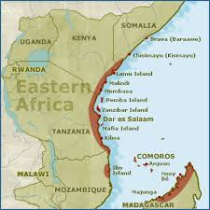
3.2 I. B. In some places, new forms of governance emerged: City States
Swahili City-States were governed by kings who controlled both trade and taxes

