Slide 1
African Slavery

Slide 2
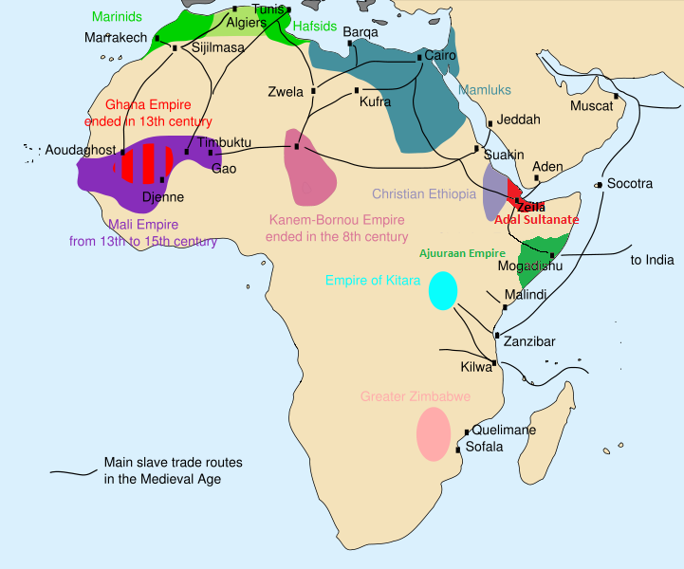
African Slave Trade
http://upload.wikimedia.org/wikipedia/commons/8/83/African_slave_trade.png

Slide 3
African Slave Trade
Europeans expanded existing African slave trade
Offered money and other commodities for growing numbers of slaves
Led Africans to go on raids to capture other Africans to sell into slavery.

Slide 4
Africans were generally enslaved for four main reasons
War
Destitution
Debt
Crime
In America, why were they slaves?

Slide 5
Demographic Patterns
Saharan trade
Mostly women
Atlantic trade
Primarily young men for hard labor

Slide 6
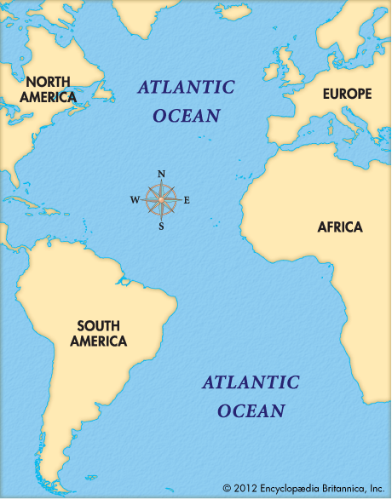
Triangular Trade
p. 440

Slide 7
Organization of the Slave Trade
Portuguese dominate first - until 1630s
Needed large numbers of slaves to work Brazilian Sugar Plantations
Dutch
Seize El Mina (1630) and rival Portuguese
English
1660s Royal African Company
French
18th century
Dahomey
Royal monopoly on flow of slaves

Slide 8
Economic importance?
Same profits as other trade
Value tied up with plantation and mining economy
Definitely ties Africa to global economy

Slide 9
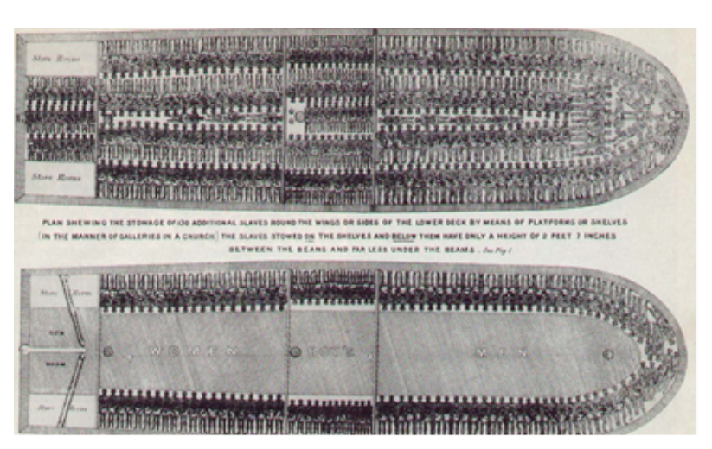
How does the way they came to America reflect the way the Americans felt about the Africans as people?

