Slide 1
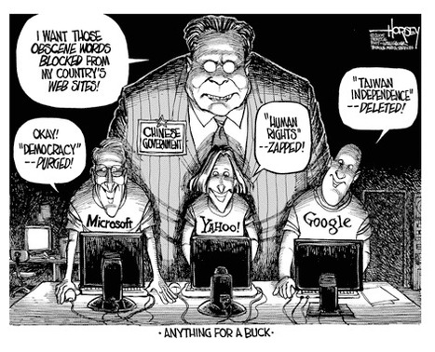
3 T’s in China

Slide 2
Call for Democracy
Late 80’s: Many Chinese studying abroad
Info about Western society reaches educated people in China
1989: Student protestors call for an end to corruption and demand resignation of Communist Party leaders
Demonstrators in Tiananmen Square (Beijing) were crushed by Chinese tanks and troops

Slide 3
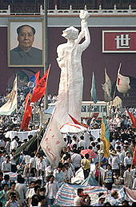
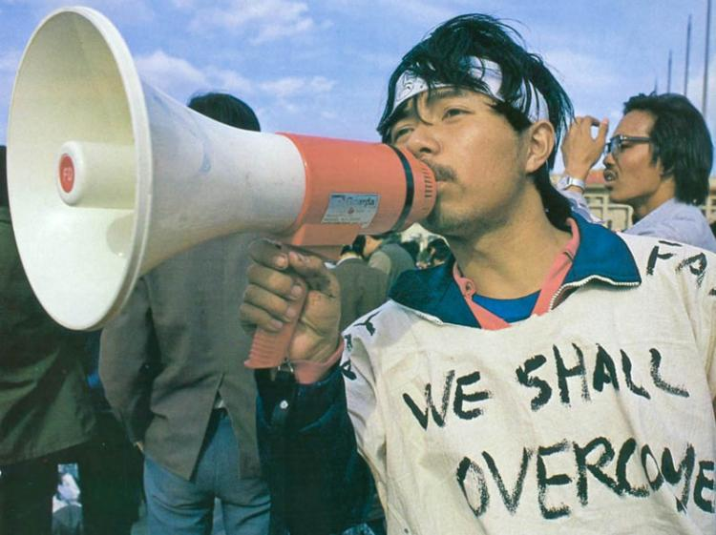
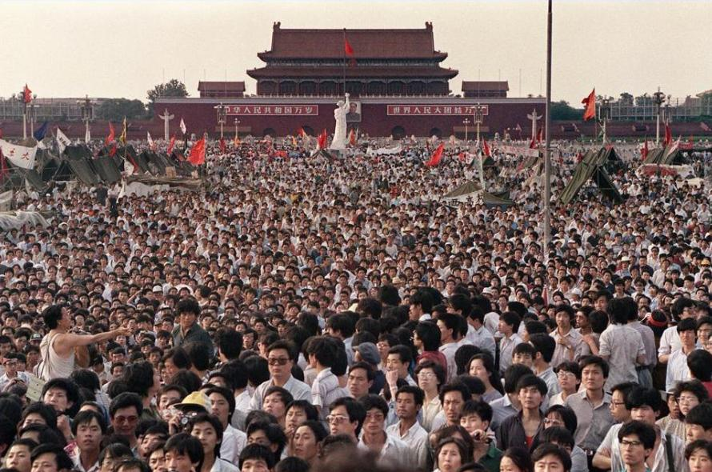
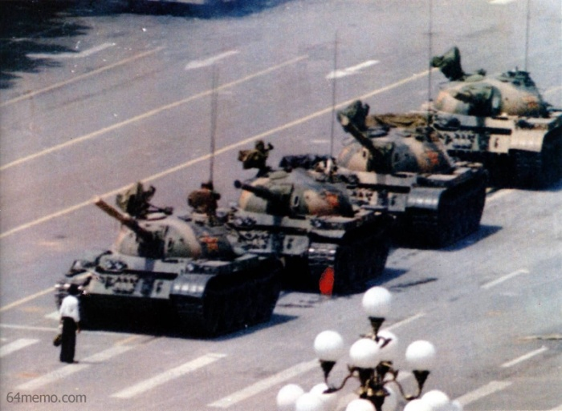

Slide 4
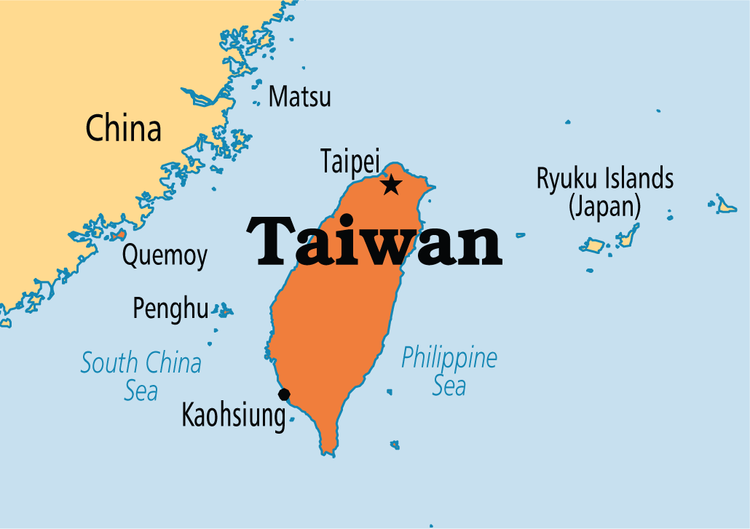
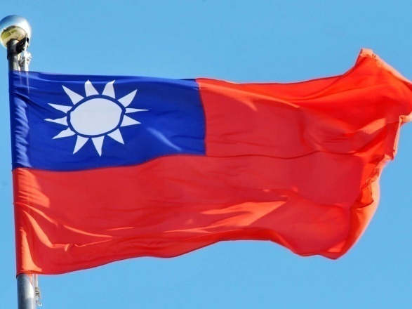
Taiwan = “Republic of China”
Official name since 1945
This is where about 2 million Nationalists fled during the Communist revolution.

Slide 5
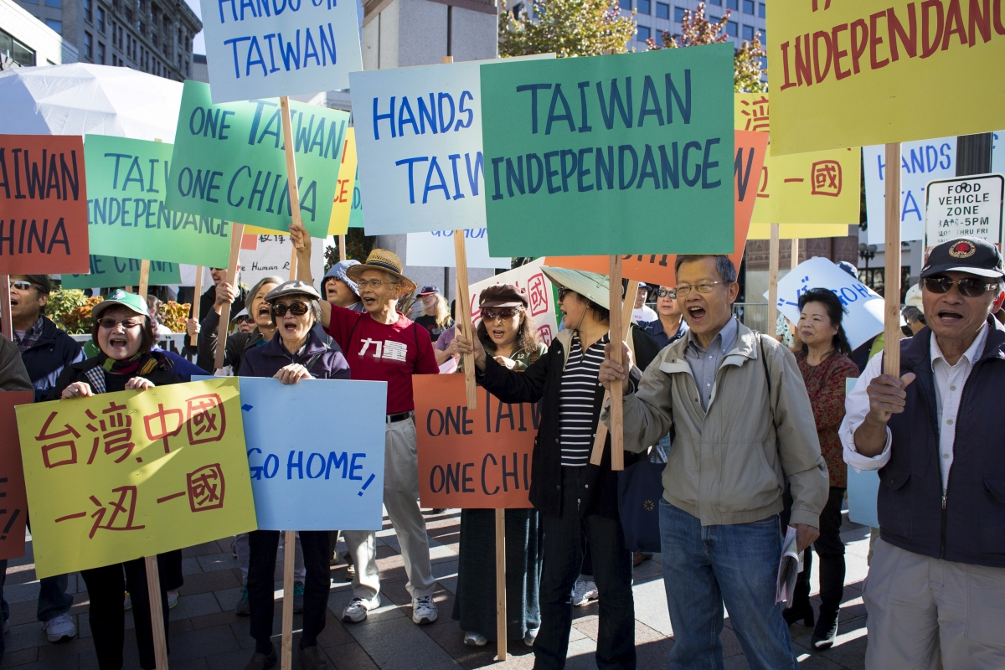
In 1972 The People’s Republic of China announced the “One China Policy”:
THERE IS ONE CHINA. TAIWAN IS PART OF CHINA.
(Photo: International Business Times / Reuters – Protestors hold a rally in Seattle against Xi’s visit)
http://www.ibtimes.co.uk/china-taiwan-leaders-hold-historic-talks-singapore-1527111

Slide 6
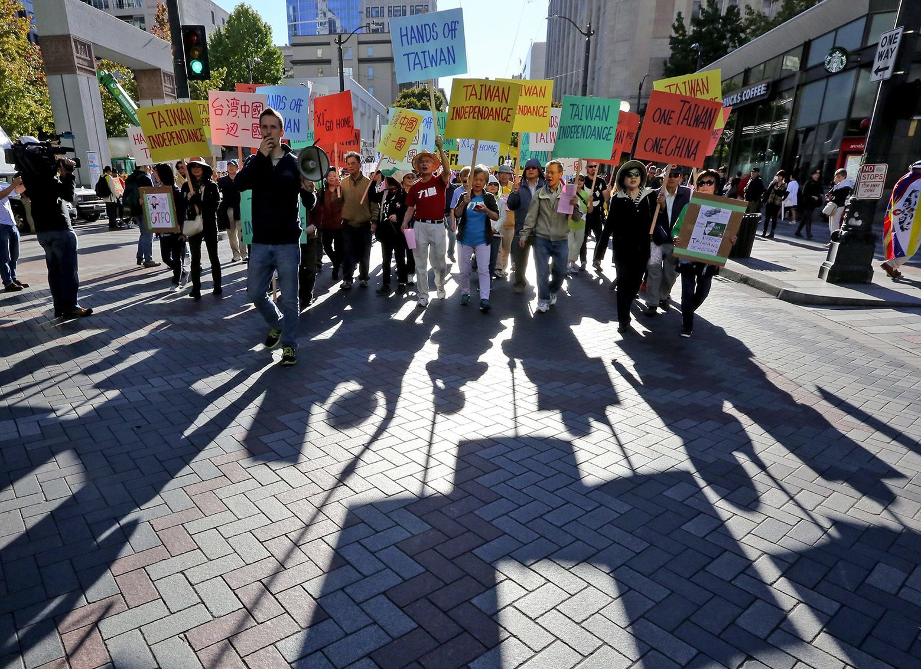
http://fapa.org/wp/wp-content/uploads/2016/04/Seattle-XJPrally.jpg

Slide 7
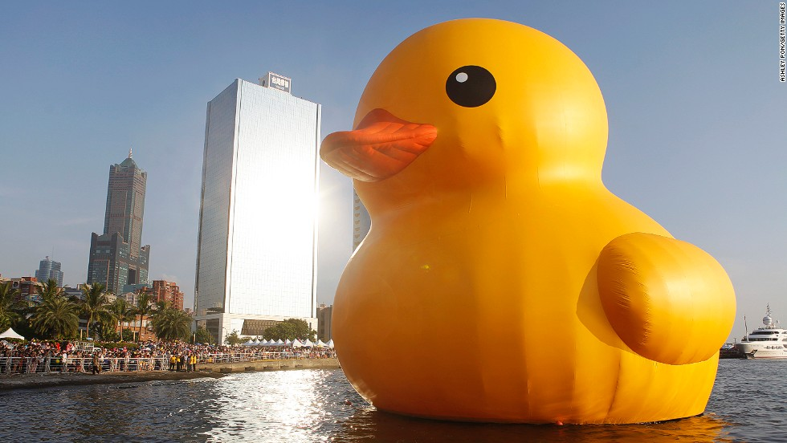
R.I.P. Giant Rubber Duck in Taiwan
Arrived Dec. 20, 2013 – Collapsed Dec. 31, 2014
http://www.cnn.com/2014/01/01/travel/taiwan-giant-rubber-duck-deflates/

Slide 8
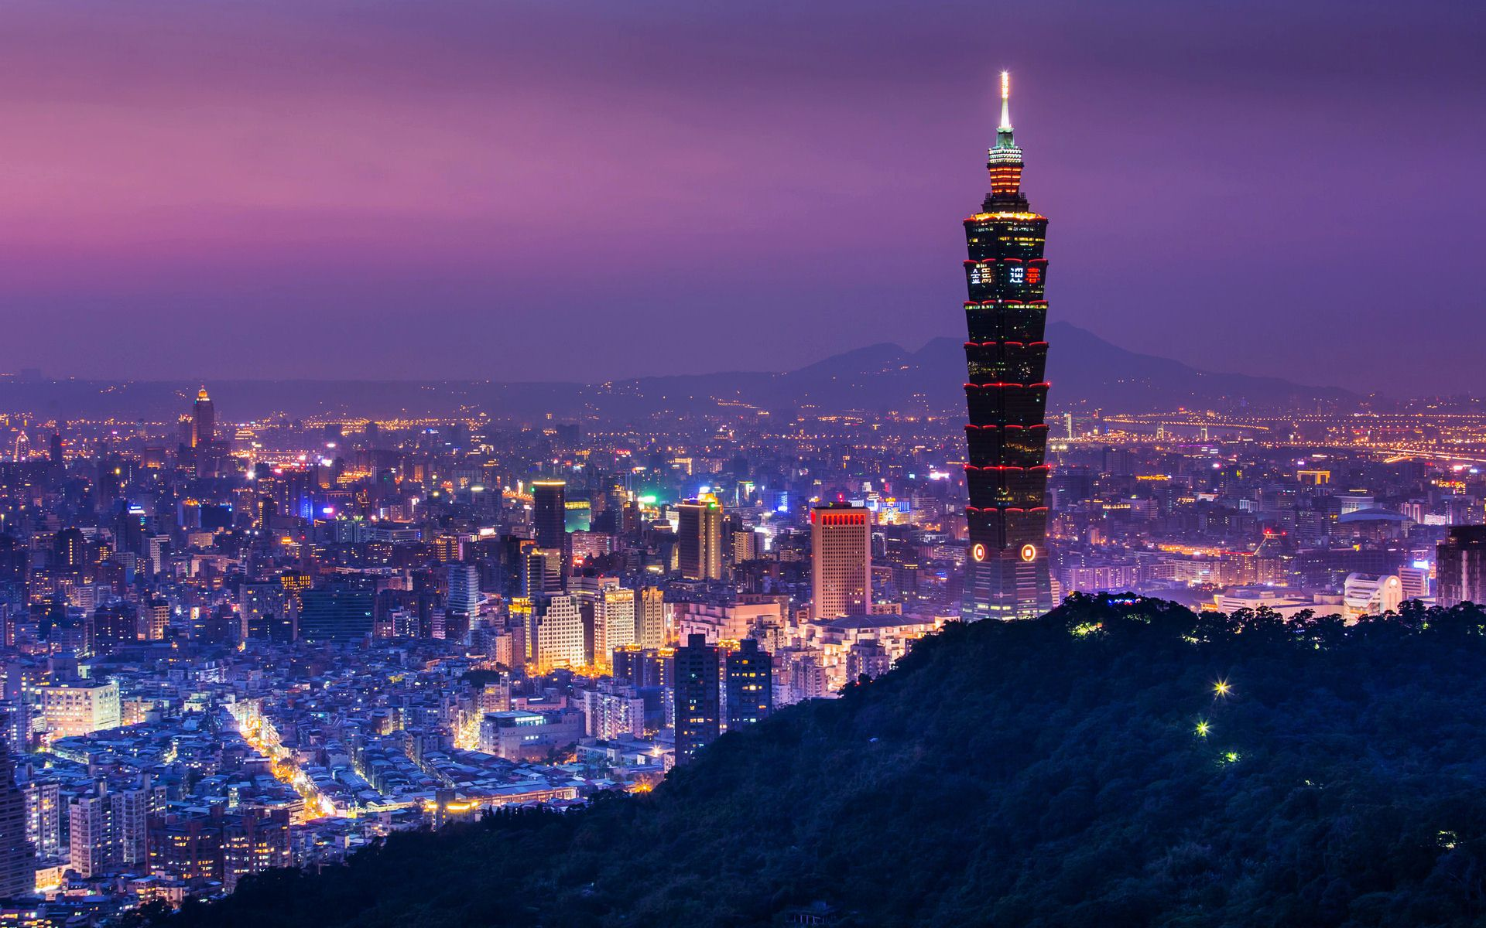
Today, Taiwan is considered a “province” of the PRC by most of the world.
It currently does not have United Nations status, but many trade partners make it the 13th largest economy in the world.
Taipei, Taiwan
http://www.usc.edu/dept/TSA/faq.html

Slide 9
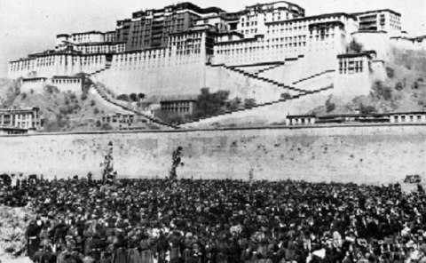
What about Tibet?
Today Tibet is widely considered to be a province of mainland China.
Many Tibetans and others consider it an “independent state under occupation” since China invaded in 1950.

Slide 10
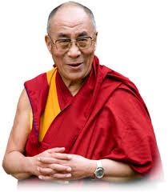
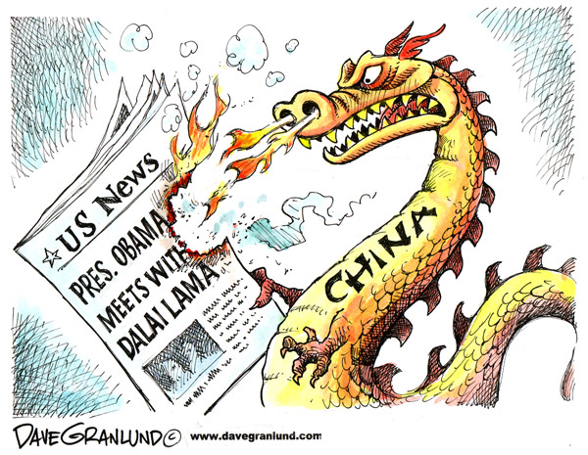
Who is the Dalai Lama?
14th Dalai Lama - Title not a person
Does not advocate for Independence just autonomy

Slide 11
